Slide 1

AIR Tracker
Automated and Intelligent Recovery of mishandled luggage
a feasibility presentation from CS 410
Green Group
presented by Jeremey Sellen
Wednesday, October 22, 2008
22 October 2008 AIR Tracker <number>

Slide 2


Organizational Chart
22 October 2008 AIR Tracker <number>

Slide 3
Overview
Problem
Solution and Use Cases
Supporting Statistics
What We Will and Will Not Do
Market Analysis
Financial Analysis
Risk Analysis
The Competition
22 October 2008 AIR Tracker <number>

Slide 4
Problem Statement
Lost luggage costs airlines billions of dollars a year. ¹
1) Customer Relationship Management (CRM) Daily
22 October 2008 AIR Tracker <number>

Slide 5
Characteristics of the Problem
Lost luggage deters return customers.
Returning lost luggage wastes the time of both
customer and airline.
Superfluous personnel and resources are involved.
Actively preventing lost luggage has not been
pursued.
Lost luggage costs the airline industry as a whole
$4 billion a year. ¹
1) CRM Daily
22 October 2008 AIR Tracker <number>

Slide 6
Solving the Lost Luggage Problem
AIR Tracker will utilize GPS technology, creating an insurance-based luggage-tracking system.
22 October 2008 AIR Tracker <number>

Slide 7
Solution Characteristics
The GPS device is able to track a bag from baggage
check-in to baggage pick-up.
The traveler will have an RFID key that is linked to
the device.
A database will maintain the key IDs and the link to
the devices.
When a bag gets checked, it will proceed through the
regular conveyer system.
Before a flight takes off, the software does a pre-
flight scan of a particular plane, requiring all of the
devices to “check-in.”
22 October 2008 AIR Tracker <number>

Slide 8
Solution Characteristics
Any bag left behind or mishandled alerts airline staff,
who can track the bag and get it to its proper flight.
If time constraints do not allow for the mishandling to
be corrected, the software reroutes the bag
immediately and changes the flight plan for the bag
by accesses to airline’s database.
22 October 2008 AIR Tracker <number>

Slide 9
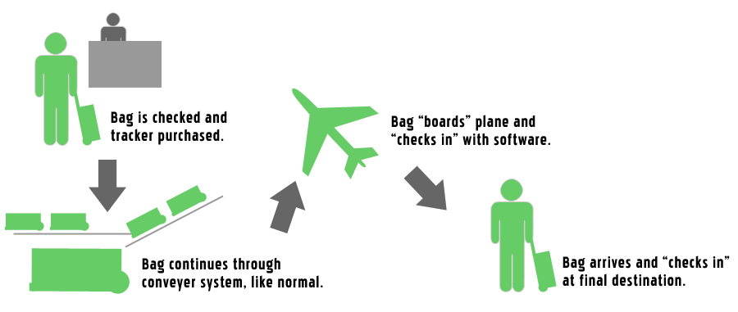
Scenario One: A Successful Flight
22 October 2008 AIR Tracker <number>

Slide 10
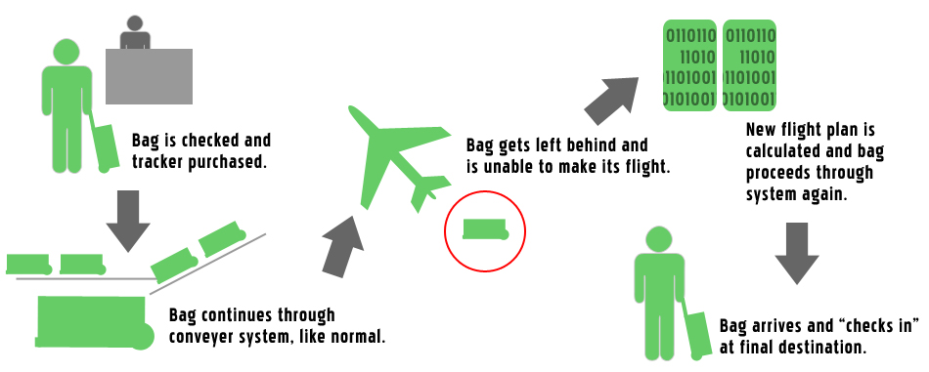
Scenario Two: A Bag Is Left Behind
22 October 2008 AIR Tracker <number>

Slide 11
Lost Luggage Statistics
In July 2007 British Airways lost an average of 28
checked bags per 1000 passengers. ¹
- AEA (Association of European Airlines)
In August 2008, bags were lost at a rate of 8,700 a
day by American based airlines. ²
- U.S. Department of Transportation
1) Seattle PI
2) Office of Aviation Enforcement
22 October 2008 AIR Tracker <number>

Slide 12
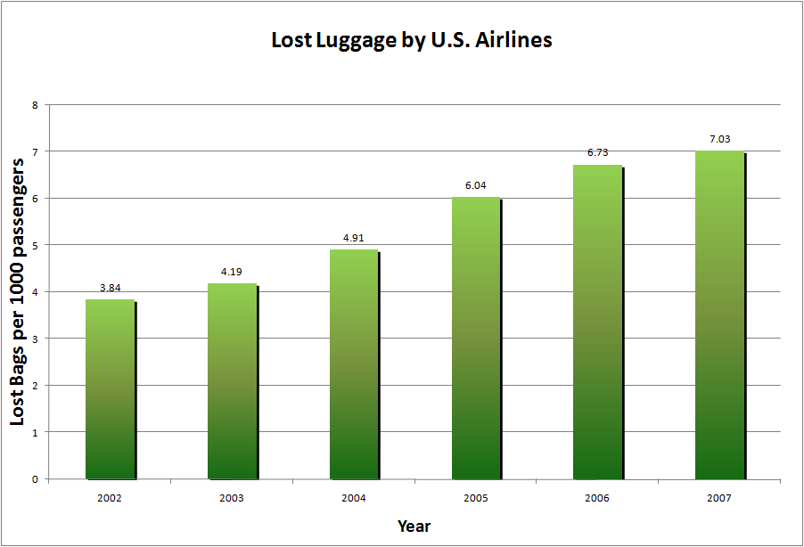
Lost Luggage by U.S. Airlines
22 October 2008 AIR Tracker <number>

Slide 13
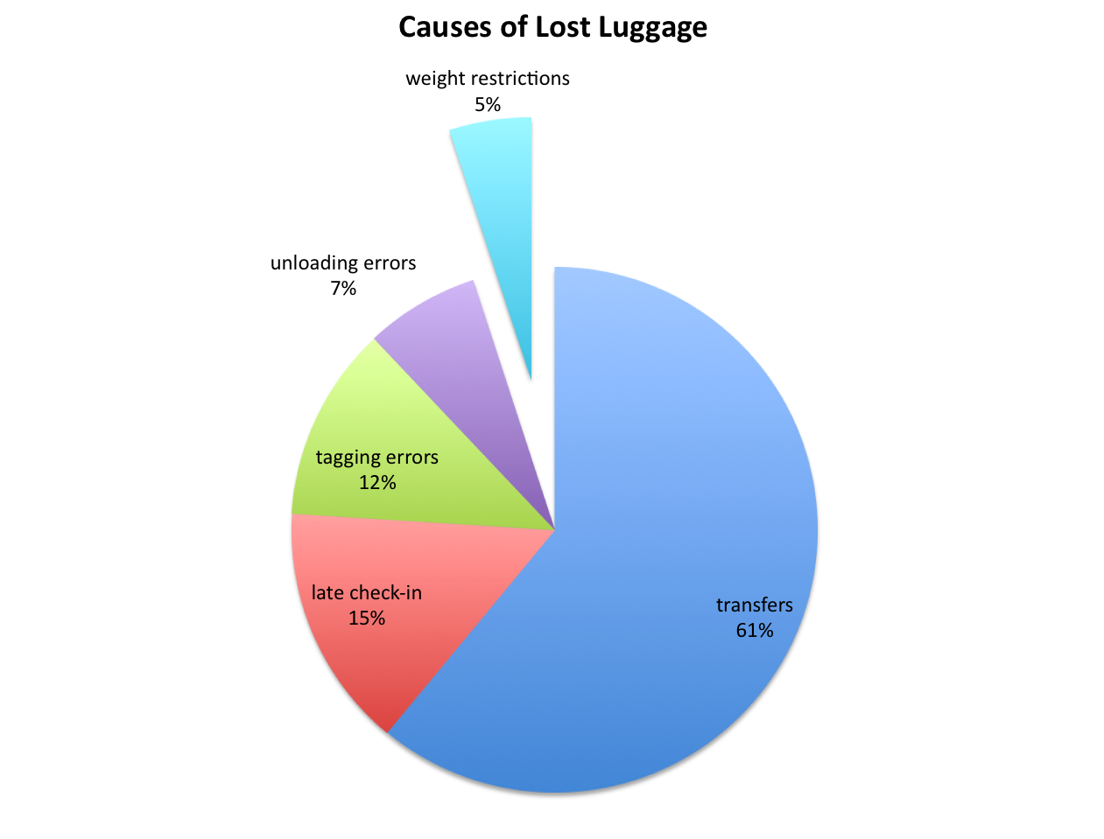
Causes of Lost Luggage
1) Popular Mechanics
22 October 2008 AIR Tracker <number>

Slide 14
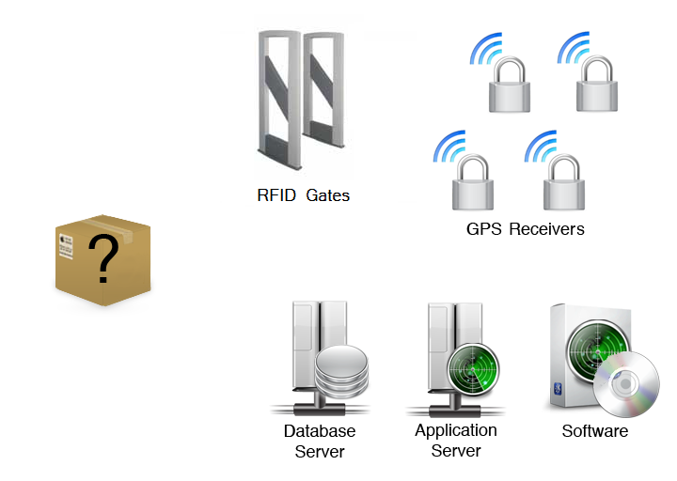
What’s in the Box?
22 October 2008 AIR Tracker <number>

Slide 15
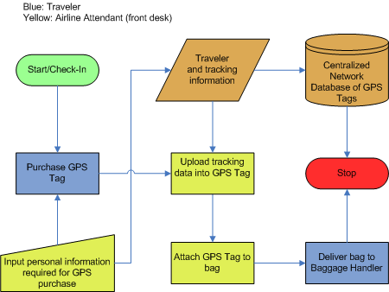
Renting AIR Tracker
22 October 2008 AIR Tracker <number>

Slide 16
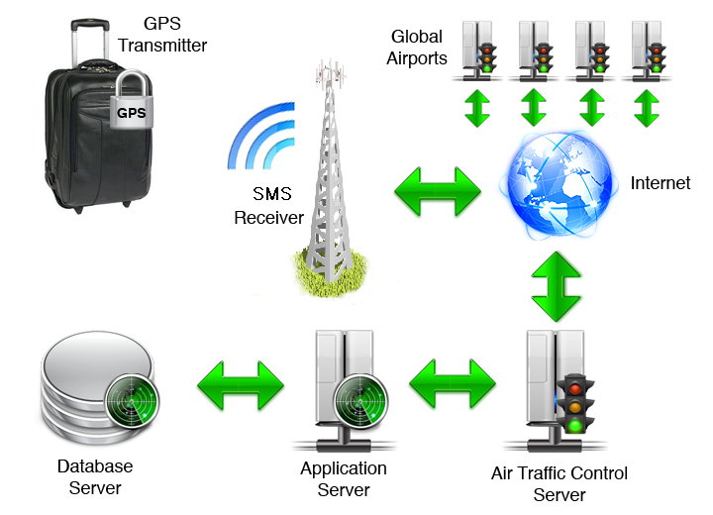
Major Functional Components Diagram
22 October 2008 AIR Tracker <number>

Slide 17
What We Will Do
We will…
track the bag from check-in to pick-up.
provide security for the related databases.
actively re-route bags if they are placed on
the wrong plane.
provide the airline master RFID keys to unlock
all locks.
provide software updates to the airlines.
22 October 2008 AIR Tracker <number>

Slide 18
What We Will Not Do
We will not…
manage weight restrictions of bags.
provide personal or identifying information in the
SMS signal.
be responsible for devices that are stolen from
airports.
provide bag tracking information to the traveler.
22 October 2008 AIR Tracker <number>

Slide 19
The Market
“[T]he government’s insistence on only one piece of hand luggage… has put huge strain on the baggage handling staff and, yes, is therefore to blame for the lost luggage.” ¹
- Martin Broughton, ex-Chairman of British Airways
“The primary reason behind mishandled bags is delayed and misconnected flights.” ²
- David A. Castelveter, Air Transport Association spokesman
“The customer is going to keep taking it on the chin.” ³
- Dean Headley, co-author of the 2007 Airline Quality Rating (referencing baggage problems)
“Airports want to meet the demands of travellers by expanding self-service to include the introduction of passenger self-boarding (35%), off-airport passenger/baggage processing (32%) and common bag drop locations (33%).” ⁴
1) Judi Bevan, The Spectator
2) Jonathan Mummolo, Washington Post
3) Jonathan Mummolo, Washington Post
4) Airport IT Trends Survey 2008
22 October 2008 AIR Tracker <number>

Slide 20




Potential Customers
Airlines
Frequent Flyers
Hotels with Remote Baggage Check-in
Other Mass
Transit Systems
22 October 2008 AIR Tracker <number>

Slide 21
AIR Tracker Costs
GPS Device ~ $200 per unit ¹
RFID Gates ~ $150 ²
Database Server ~ $6,000 ³
Application Server ~ $6,000 ⁴
Personnel
  Manager ~ $85,000 per year ⁵
  Software engineer ~ $60,000 per year ⁶
1) Mukund Halthore, Falcom Wireless Communications
2) Digi-Key Corporation
3) IBM
4) IBM
5) PayScale
6) PayScale
22 October 2008 AIR Tracker <number>

Slide 22
Airline Costs
Initial Costs
GPS Device ~ $300 per unit
RFID Gates ~ $150
Database Server ~ $6,000
Application Server ~ $6,000
Software ~ $250 per license
______________________________________
$12,150 base price
+ $300 per unit
+ $250 per license
22 October 2008 AIR Tracker <number>

Slide 23
Pros of Solution
Minimal modifications are needed to existing
systems.
The system will correct human error.
The traveler needs no major interaction with the
system.
Hardware is rugged and simple.
GPS is reliable.
22 October 2008 AIR Tracker <number>

Slide 24
Cons of Solution
AIR Tracker requires access to airline databases
(possible security issue).
GPS may not transmit or receive while in the hull of
the airplane.
Hardware shows the potential to be expensive to
manufacture (at least initially).
AIR Tracker is optional for the traveler.
The RFID key is something else for the traveler to
carry and keep track of.
22 October 2008 AIR Tracker <number>

Slide 25
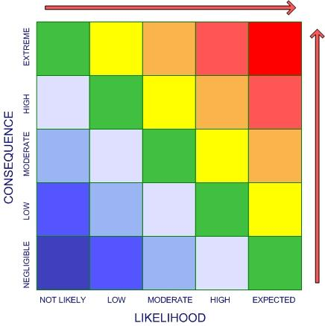
Risks
1. Competition Solving the Problem First
2. Not Enough Customers Attracted
3. Unit Unable to Get a GPS Signal
4. Customers Unable to Install SW/HW
5. Dependency on GPS Satellites
6. Device Gets Destroyed En Route
7. Unintentional Personal
Information Leak
6
1
7
3, 4
2
5
22 October 2008 AIR Tracker <number>

Slide 26
The Competition
GlobalBagTag
Symbol Technologies System
AIR Tracker
attaches to luggage
Yes
Yes
Yes
traceable if sent to
wrong location
Yes
Yes
Yes
traceable if completely lost
No
No
Yes
reusable
Yes
No
Yes
SMS / text message support
Yes
No
Yes
tied to itinerary
Yes
Yes
Yes
supports existing RFID architectures
Yes
Yes
Yes
22 October 2008 AIR Tracker <number>

Slide 27
The Competition: RFID
RFID has a different role: to improve accuracy and
feasibility of scans.
IATA¹ has said that RFID will not be rolled out as an
industry-wide solution to address the problem of lost
bags after trials showed that RFID would only
prevent 20% of the annual lost-bag total.²
It complements AIR Tracker because it can provide
security for trackers.
1) IATA – International Air Transport Association
2) David Bicknell
22 October 2008 AIR Tracker <number>

Slide 28
The Competition: GlobalBagTag
Each GlobalBagTag has a unique serial number which
enables it to be traced to the owner via the
globalbagtag.com website.
If somebody finds the bag, he/she may report
it online.¹
It does not prevent bags from being lost or stolen,
it only identifies them.
1) globalbagtag.com
22 October 2008 AIR Tracker <number>

Slide 29
Conclusion
“If an airline loses a passenger’s bag, you raise the possibility of losing the customer for the long term.” ¹
Billions in lost revenue and wasted man-hours takes away from the customer-oriented business of air travel.
AIR Tracker is the solution!
1) Francesca Levy, Business Week
22 October 2008 AIR Tracker <number>

Slide 30
References
“Air Travel Consumer Reports for 2008.” airconsumer.ost.dot.gov. 30 JUL
2008. Office of Aviation Enforcement. 01 Oct 2008 <http://airconsume
r.ost.dot.gov/reports/atcr08.htm>.
“Airport IT Trends Survey 2008.” sita.aero. SITA. 21 Oct 2008 <http://www
.sita.aero/News_Centre/Industry_surveys_and_trends/Airport_IT_trends
/default.htm>.
Bevan, Judi. “Coping with crisis, climate change — and lost luggage.”
spectator.co.uk. 07 Nov 2007. The Spectator. 20 Oct 2008 <http://ww
w.spectator.co.uk/the-magazine/business/334921/coping-with-crisis-cli
mate-change-and-lost-luggage.html>.
Bicknell, David. “Airlines reject RFID as universal industry solution to
lost bags.” ComputerWeekly.com. 30 Jul 2008. Computer Weekly. 20
Oct 2008 <http://www.computerweekly.com/Articles/2008/06/20/2311
41/airlines-reject-rfid-as-universal-industry-solution-to-lost.htm>.
“Frequently Asked Questions.” globalbagtag.com. Global Bag Tag. 20
Oct 2008 <http://www.globalbagtag.com/faq.cfm>.
Halthore, Mukund. “RE: Contact request from website (Germany).” Email to
Joel Elixson concerning the wholesale cost of GPS/GSM modules. 21 Oct
2008.
“IBM System x3450.” IBM. 2008. IBM. 21 Oct 2008 <http://www-304.ibm.co
m/shop/americas/webapp/wcs/stores/servlet/default/CategoryDisplay
?categoryId=4611686018425232005&storeId=1&catalogId=-840&langId=
1>.
James, Andrea. “Seattle firm sues British Airways over lost luggage.”
Seattle PI. 13 Nov 2007. Seattle PI. 21 Oct 2008 <http://seattlepi.nwso
urce.com/business/339434_lostluggage13.html>.
22 October 2008 AIR Tracker <number>

Slide 31
References
Levy, Francesca. “The Airlines’ Bag Reflex.” BusinessWeek.com. 30 Jul
2008. Business Week. 20 Oct 2008 <http://www.businessweek.com/life
style/content/jul2008/bw20080729_355085.htm>.
Mummolo, Jonathan. “Now Arriving At Carousel 1, Far Fewer Of Your
Bags.” Washingtonpost.com. 01 Oct 2007. Washington Post. 20 Oct 20
08 <http://www.washingtonpost.com/wpdyn/content/article/2007/09
/30/AR2007093001653.html?sid=ST2007100200809>.
“Project Manager, IT Job Salaries in Virginia.” PayScale. 2008. 21 Oct
2008 <http://www.payscale.com/af/calc.aspx?job=project%20manager
&city=Norfolk&state=VA>.
Scottberg, Erin. “Anatomy of Lost Luggage: How to Track Your Bags
(and Save ’Em).” Popular Mechanics. 20 Dec 2007. Popular
Mechanics. 21 Oct 2008 <http://www.popularmechanics.com/technolo
gy/transportation/4237628.html>.
“Software Engineer / Developer / Programmer Job Salaries in Virginia
Beach-Norfolk-Newport News, VA-NC.” PayScale. 2008. 21 Oct 2008
<http://www.payscale.com/af/calc.aspx?job=program mer&city=Norfo
lk&state=VA>.
22 October 2008 AIR Tracker <number>

Slide 32
Questions?
22 October 2008 AIR Tracker <number>

